Slide 1
COMP 469
Introduction to Artificial Intelligence
Chapter 8
First-Order Logic
Objects • Relations • Quantifiers • Knowledge Engineering
CSU Channel Islands • University-level AI lecture deck
01
Notes:
Chapter 8 title Frame the lecture as a shift from “AI that searches” to “AI that represents and reasons.” In Chapters 3 and 5, agents searched over states and moves; in Chapter 7, agents used propositional logic. Chapter 8 makes logic more expressive by adding objects, relations, functions, and quantifiers. Useful opening analogy: propositional logic is like labeling individual sticky notes; first-order logic is like designing a language for the whole room and the relationships among everything in it. Teaching gotcha: Students often memorize symbols but miss the modeling choice. Keep asking: what exists in our world, what names do we give it, and what can the KB prove?

Slide 2
Course map
02
TODAY’S AGENDA
One chapter, one story: from facts to structured knowledge.
Why propositional logic is not enough
What first-order logic adds: objects, relations, functions
How quantifiers let us say “all” and “some”
How database semantics changes the rules
How knowledge engineering builds a useful KB
Analogy
Think of this lecture as upgrading from a spreadsheet of isolated cells to a map of people, objects, and relationships.
Class check
By the end, students should translate English rules into FOL and explain what a model makes true.
Notes:
Agenda Keep the roadmap visible: representation first, syntax/semantics second, then knowledge engineering. Emphasize that FOL is not just “more notation.” It changes what an AI system can talk about. Students may be intimidated by symbols; repeatedly connect each symbol back to English sentences and small domains. Teaching gotcha: Students often memorize symbols but miss the modeling choice. Keep asking: what exists in our world, what names do we give it, and what can the KB prove?

Slide 3
Chapter 8
03
BIG IDEA: STRUCTURED REPRESENTATION
Atomic states hide internal structure
Factored states expose variables
Structured representations expose objects and relationships
FOL lets agents reason about whole classes of things
Analogy
A phone contact list stores names and numbers; a social network stores people and relationships. FOL is closer to the social network.
Class check
Ask: What is easier to represent in FOL than propositional logic: “all safe squares,” or “S2,3 is safe”?
Notes:
Big idea: structured representation Use this as a bridge from Chapter 2’s representation types. Propositional logic can say that a specific square is breezy; FOL can say why any square is breezy. The analogy helps students see that the main upgrade is not truth values, but relational structure. Teaching gotcha: Students often memorize symbols but miss the modeling choice. Keep asking: what exists in our world, what names do we give it, and what can the KB prove?

Slide 4
COMP 469
8.1 Representation Revisited
Why representation language matters
04
Notes:
8.1 Representation Revisited The first section asks what we want from a knowledge representation language. The key distinction is procedural code versus declarative knowledge. Tell students: a program can store facts, but logic lets us derive facts. Teaching gotcha: Students often memorize symbols but miss the modeling choice. Keep asking: what exists in our world, what names do we give it, and what can the KB prove?

Slide 5
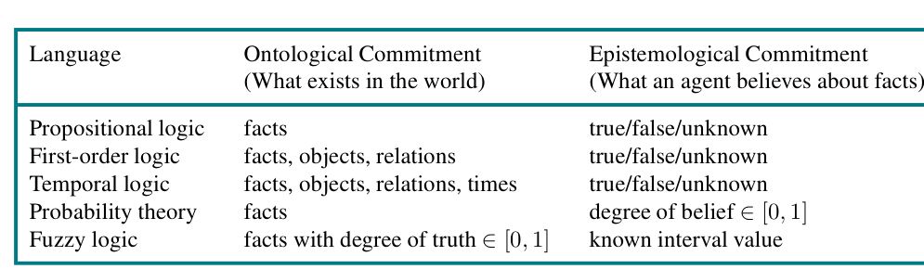
Chapter 8
05
PROGRAMMING DATA VS. LOGICAL KNOWLEDGE
Data structures can store facts
But they do not infer general consequences by themselves
Logic separates knowledge from inference
This is the declarative advantage
Figure 8.1 compares commitments of formal languages.
Notes:
Programming data vs. logical knowledge Use the Wumpus array example. In Python, World[2,2] = Pit stores one fact. It does not automatically know that adjacent squares are breezy unless the programmer writes the procedure. In logic, the rule is represented and inference can apply it. The figure helps students compare languages by what they assume exists and what kind of belief values are allowed. Teaching gotcha: Students often memorize symbols but miss the modeling choice. Keep asking: what exists in our world, what names do we give it, and what can the KB prove?

Slide 6
Chapter 8
06
DECLARATIVE VS. PROCEDURAL KNOWLEDGE
Procedural: “how to compute it”
Declarative: “what is true”
Inference engine handles consequences
Domain knowledge becomes easier to inspect
Analogy
A recipe tells you how to bake a cake; a nutrition label tells you what is true about ingredients. Logic is more like the label plus rules for reasoning.
KB + inference ⇒ new facts
Class check
Which is easier to debug: hidden code logic or explicit domain rules?
Notes:
Declarative vs. procedural knowledge Students often think “logic is code.” Clarify that a logic sentence is not an instruction to execute; it is an assertion. Inference procedures use assertions, but the domain rule itself is not a Python if-statement. Teaching gotcha: Students often memorize symbols but miss the modeling choice. Keep asking: what exists in our world, what names do we give it, and what can the KB prove?

Slide 7
Chapter 8
07
PROPOSITIONAL LOGIC: USEFUL BUT VERBOSE
Each proposition names one fact
Good for small fixed worlds
Poor at repeated structure
Rules must be copied for each square/time/object
Analogy
Writing one breeze rule per Wumpus square is like printing a separate syllabus for every student with only the name changed.
B₁,₁ ⇔ (P₁,₂ ∨ P₂,₁)
Class check
How many breeze rules for a 100 x 100 grid?
Notes:
Propositional logic: useful but verbose Tie this to Chapter 7. Students already saw propositional Wumpus World. The problem is not that propositional logic is wrong; it is that it lacks variables and quantifiers, so it cannot naturally say a general rule once. Teaching gotcha: Students often memorize symbols but miss the modeling choice. Keep asking: what exists in our world, what names do we give it, and what can the KB prove?

Slide 8
Chapter 8
08
FOL: SAY THE RULE ONCE
Objects: squares, agents, pits
Relations: Adjacent(x,y), Pit(x)
Variables: reusable placeholders
Quantifiers: all/some objects
Analogy
Instead of writing individual parking tickets by hand, write a parking rule that applies to every car in the lot.
∀s Breezy(s) ⇔ ∃p(Pit(p) ∧ Adjacent(p,s))
Class check
What does p stand for? A specific pit? Any possible pit?
Notes:
FOL: say the rule once Use the formula as the center of the lecture. Read it in English slowly: for every square s, s is breezy iff there exists a square p such that p has a pit and p is adjacent to s. Students should hear FOL as structured English, not as decoration. Teaching gotcha: Students often memorize symbols but miss the modeling choice. Keep asking: what exists in our world, what names do we give it, and what can the KB prove?

Slide 9
Chapter 8
09
REPRESENTATION LANGUAGE GOALS
Declarative: facts are stated explicitly
Compositional: meaning comes from parts
Expressive: can handle partial information
Unambiguous: avoids ordinary language confusion
Analogy
LEGO bricks are compositional: meaning comes from how pieces combine. FOL sentences work the same way.
Class check
Point to a sentence and ask: which pieces carry meaning?
Notes:
Representation language goals This slide previews the chapter summary. Compositionality is important: if students know the meaning of parts, they can evaluate the whole. Natural language is expressive, but not reliably context-independent or unambiguous. Teaching gotcha: Students often memorize symbols but miss the modeling choice. Keep asking: what exists in our world, what names do we give it, and what can the KB prove?

Slide 10
Chapter 8
10
NATURAL LANGUAGE IS NOT A CLEAN KB
Very expressive, but context-dependent
Ambiguous words break formal reasoning
“Look!” means different things in different contexts
Formal logic trades flexibility for precision
Analogy
A text message saying “it’s cold” could mean weather, food, attitude, or a computer lab. A KB needs the intended meaning.
Class check
Ask: What would a robot need to know to interpret “put it over there”?
Notes:
Natural language is not a clean KB Students may ask why we do not just use English. Acknowledge modern NLP, but stress that Chapter 8 is about formal semantics: exact conditions under which a sentence is true. Natural language requires context, common sense, and pragmatics. Teaching gotcha: Students often memorize symbols but miss the modeling choice. Keep asking: what exists in our world, what names do we give it, and what can the KB prove?

Slide 11
Chapter 8
11
FIRST-ORDER LOGIC IN ONE SENTENCE
FOL talks about individual objects
It names relationships among objects
It uses variables to state general patterns
It supports sound, model-based semantics
Analogy
A classroom seating chart names people; FOL also represents who sits next to whom, who teaches whom, and rules about all students.
Objects + Relations + Quantifiers
Class check
Have students name 3 objects and 2 relations in this room.
Notes:
First-order logic in one sentence Use this as a low-stakes exercise. Objects: students, chairs, laptop, projector. Relations: SittingIn, ConnectedTo, Teaches, Owns. This grounds the notation in everyday modeling. Teaching gotcha: Students often memorize symbols but miss the modeling choice. Keep asking: what exists in our world, what names do we give it, and what can the KB prove?

Slide 12
COMP 469
8.2 Syntax and Semantics of FOL
How FOL sentences get meaning
12
Notes:
8.2 Syntax and Semantics of FOL This is the technical core. Keep returning to “syntax is grammar, semantics is truth.” The syntax tells us what strings are legal. The semantics tells us what those strings mean in a model. Teaching gotcha: Students often memorize symbols but miss the modeling choice. Keep asking: what exists in our world, what names do we give it, and what can the KB prove?

Slide 13
Chapter 8
13
SYNTAX VS. SEMANTICS
Syntax: what counts as a legal sentence
Semantics: what makes a sentence true
Models connect symbols to a world
Inference relies on truth across models
Analogy
Syntax is like grammar rules; semantics is whether the sentence actually describes the room we are in.
model ⟹ truth value
Class check
Can a syntactically valid sentence be false? Yes.
Notes:
Syntax vs. semantics This is a recurring gotcha: valid grammar does not imply truth. “King(Richard)” can be well-formed and false in the intended model. Make students separate form from truth. Teaching gotcha: Students often memorize symbols but miss the modeling choice. Keep asking: what exists in our world, what names do we give it, and what can the KB prove?

Slide 14
Chapter 8
14
FORMAL LANGUAGE COMMITMENTS
Languages differ in what they assume exists
FOL adds objects and relations to facts
Probability adds degrees of belief
Fuzzy logic changes truth values
Figure 8.1: ontological and epistemological commitments.
Notes:
Formal language commitments Use the table to define two vocabulary words. Ontological commitment: what the language assumes exists. Epistemological commitment: what beliefs or truth statuses the language can express. FOL still uses true/false/unknown, but the things it talks about are richer. Teaching gotcha: Students often memorize symbols but miss the modeling choice. Keep asking: what exists in our world, what names do we give it, and what can the KB prove?

Slide 15
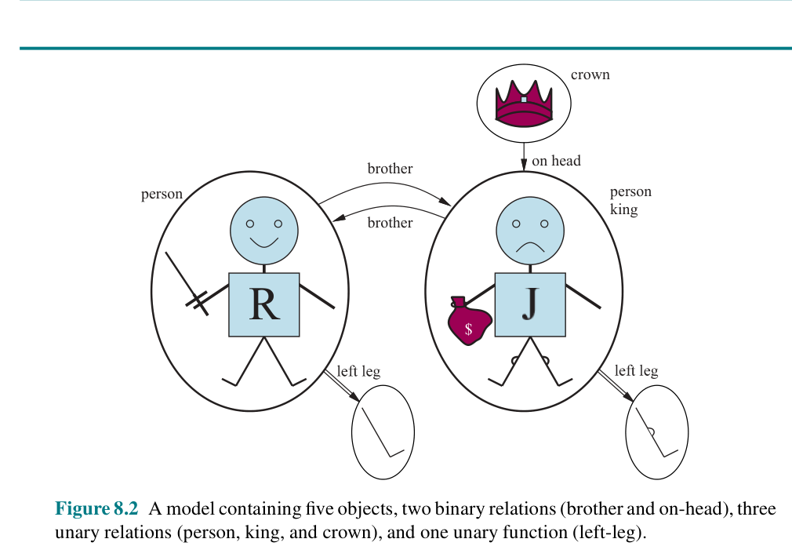
Chapter 8
15
MODELS FOR FIRST-ORDER LOGIC
A model contains objects
Relations are sets of tuples
Functions map objects to objects
Truth depends on the interpretation
Figure 8.2: Richard, John, crown, relations, and left-leg function.
Notes:
Models for first-order logic Walk through the picture: two people, a crown, two legs, brother relation, on-head relation, properties like person/king/crown, and LeftLeg as a function. The point is not medieval history; it is how a possible world is structured. Teaching gotcha: Students often memorize symbols but miss the modeling choice. Keep asking: what exists in our world, what names do we give it, and what can the KB prove?

Slide 16
Chapter 8
16
DOMAIN: THE UNIVERSE OF OBJECTS
Every FOL model has a nonempty domain
Objects may be named or unnamed
Objects can have multiple names unless ruled out
The KB restricts which models are possible
Analogy
The domain is the cast list of a play. Not every character must have a speaking role or a name.
Domain = {objects in the possible world}
Class check
Can an object exist in a model without a constant symbol naming it?
Notes:
Domain: the universe of objects Students often assume names and objects are one-to-one. Standard FOL does not assume that. Multiple constants may name the same object, and some objects may have no constant name. Database semantics later changes this. Teaching gotcha: Students often memorize symbols but miss the modeling choice. Keep asking: what exists in our world, what names do we give it, and what can the KB prove?

Slide 17
Chapter 8
17
RELATIONS AS TUPLES
Unary relations are properties: Person(x)
Binary relations connect pairs: Brother(x,y)
Higher-arity relations connect ordered tuples
A relation is true for selected tuples
Analogy
A class roster is a unary relation: Student(x). A group project table is a relation among several people.
Brother = {〈Richard, John〉, 〈John, Richard〉}
Class check
Why does order matter in Brother(x,y) less than in Parent(x,y)?
Notes:
Relations as tuples Explain that relations are not magic verbs. Formally, a relation is a set of tuples. For asymmetric relations like Parent(x,y), order matters greatly. For symmetric relations like Sibling(x,y), the KB needs an axiom to ensure both directions. Teaching gotcha: Students often memorize symbols but miss the modeling choice. Keep asking: what exists in our world, what names do we give it, and what can the KB prove?

Slide 18
Chapter 8
18
FUNCTIONS AS UNIQUE MAPPINGS
A function returns exactly one object for each input tuple
Example: LeftLeg(John)
In FOL, functions are total
Function terms are names, not subroutines
Analogy
A student ID function maps each student to one ID number. It is not a program call; it is a naming relationship.
LeftLeg(John) refers to one object
Class check
Gotcha: What does LeftLeg(Crown) mean under total-function semantics?
Notes:
Functions as unique mappings This is a surprising technical point. FOL functions must have a value for every input, even weird ones. Tell students: as long as we avoid asking irrelevant questions, the weird total-function cases do not matter. Teaching gotcha: Students often memorize symbols but miss the modeling choice. Keep asking: what exists in our world, what names do we give it, and what can the KB prove?

Slide 19
Chapter 8
19
INTERPRETATIONS: SYMBOLS NEED MEANING
Constants map to objects
Predicates map to relations
Functions map to functions
Different interpretations can make different sentences true
Analogy
A label on a moving box is only useful if everyone agrees which box it points to.
John ↦ King John
Class check
If John and Richard both point to the crown, is that allowed in standard FOL?
Notes:
Interpretations: symbols need meaning Emphasize that the interpretation is the bridge between symbols and the world. Without it, symbols are just marks. The KB can rule out unintended interpretations by adding sentences like John ≠ Richard. Teaching gotcha: Students often memorize symbols but miss the modeling choice. Keep asking: what exists in our world, what names do we give it, and what can the KB prove?

Slide 20
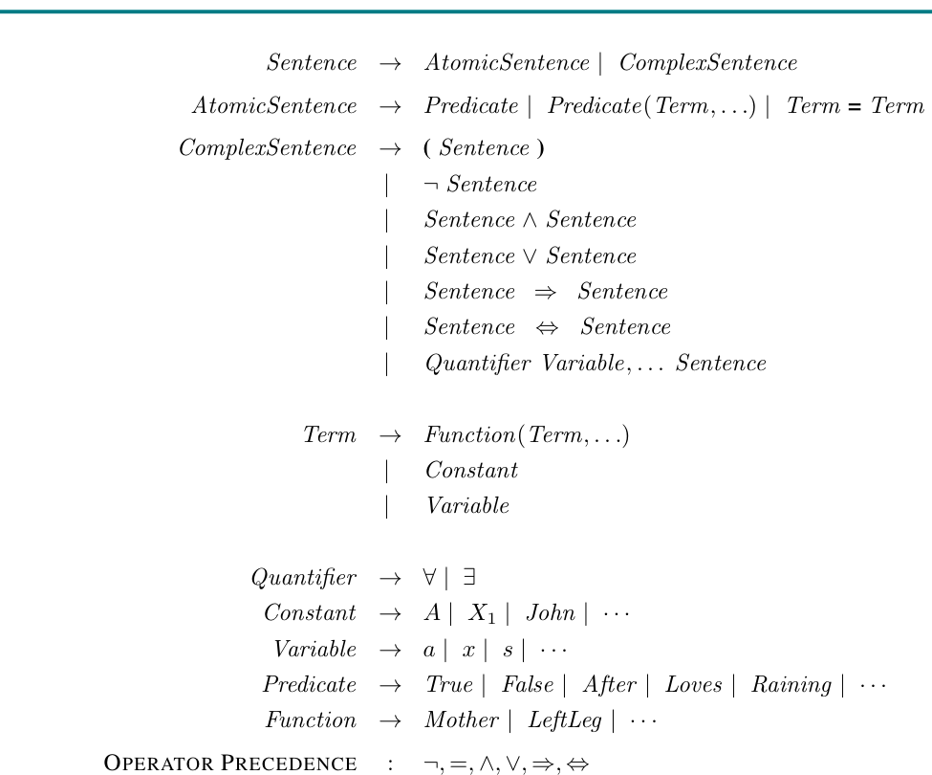
Chapter 8
20
FOL SYNTAX: THE GRAMMAR OF SENTENCES
Sentences can be atomic or complex
Terms refer to objects
Predicates make claims about terms
Quantifiers bind variables
Figure 8.3: Backus–Naur grammar for FOL.
Notes:
FOL syntax: the grammar of sentences Do not dwell on every line of the grammar. Use it to show the hierarchy: terms are object expressions; predicates form atomic sentences; connectives and quantifiers build complex sentences. The key is to help students parse formulas without panic. Teaching gotcha: Students often memorize symbols but miss the modeling choice. Keep asking: what exists in our world, what names do we give it, and what can the KB prove?

Slide 21
Chapter 8
21
CONSTANTS, VARIABLES, PREDICATES, FUNCTIONS
Constants: Richard, John, C₁
Variables: x, y, s, t
Predicates: King(x), Gate(g)
Functions: LeftLeg(x), In(1,C₁)
Analogy
Constants are named people on a guest list; variables are blank lines; predicates are claims; functions are unique references.
Class check
Which symbol type is Student(x)? Which type is Mother(x)?
Notes:
Constants, variables, predicates, functions Use examples from their labs: Square(1,2), Pit(s), Adjacent(s,p), Signal(t). Students should classify symbols before translating. This prevents later mistakes with arity and function/predicate confusion. Teaching gotcha: Students often memorize symbols but miss the modeling choice. Keep asking: what exists in our world, what names do we give it, and what can the KB prove?

Slide 22
Chapter 8
22
ARITY: HOW MANY ARGUMENTS?
Predicate and function symbols have arity
Person(x) has arity 1
Brother(x,y) has arity 2
Connected(t₁,t₂) has arity 2
Analogy
Arity is like the number of seats at a table. A two-seat predicate expects exactly two objects.
Connected(Out(1,X₁), In(1,X₂))
Class check
What goes wrong with Brother(Richard)?
Notes:
Arity: how many arguments? Arity errors are easy for students to make. They should learn to check every predicate like a function signature in programming. Unlike Python, a logic text may not immediately throw a runtime error; it may just be malformed. Teaching gotcha: Students often memorize symbols but miss the modeling choice. Keep asking: what exists in our world, what names do we give it, and what can the KB prove?

Slide 23
Chapter 8
23
TERMS: OBJECT-REFERRING EXPRESSIONS
Constants are terms
Variables are terms
Function applied to terms is a term
A ground term has no variables
Analogy
“The instructor of COMP 469” is a complex name. It refers to an object without using that object’s personal name.
LeftLeg(John), Mother(John), In(1,C₁)
Class check
Is King(John) a term or a sentence?
Notes:
Terms: object-referring expressions Make the distinction clear: terms refer to objects; sentences are true or false. King(John) is an atomic sentence because it makes a claim. LeftLeg(John) is a term because it names an object. Teaching gotcha: Students often memorize symbols but miss the modeling choice. Keep asking: what exists in our world, what names do we give it, and what can the KB prove?

Slide 24
Chapter 8
24
ATOMIC SENTENCES: BASIC CLAIMS
An atom applies a predicate to terms
It is true if the relation holds in the model
Atoms are the building blocks of FOL
Equality is also atomic
Analogy
A basic database row like Enrolled(Ana, COMP469) is an atomic fact.
Brother(Richard, John)
Class check
What relation must hold for this atom to be true?
Notes:
Atomic sentences: basic claims Atoms are simple but powerful. Remind students that truth depends on the model and interpretation. The sentence is not true because it is written; it is true if the appropriate tuple is in the relation. Teaching gotcha: Students often memorize symbols but miss the modeling choice. Keep asking: what exists in our world, what names do we give it, and what can the KB prove?

Slide 25
Chapter 8
25
COMPLEX SENTENCES: CONNECT ATOMS
Use ¬, ∧, ∨, ⇒, ⇔ just like propositional logic
FOL adds richer atoms underneath
Connectives do not change object references
They combine truth conditions
Analogy
Complex sentences are like combining simple statements with “and,” “or,” “if,” and “if and only if.”
King(John) ∧ ¬King(Richard)
Class check
What are the two atomic claims inside this sentence?
Notes:
Complex sentences: connect atoms Students have already seen connectives in Chapter 7. The new part is that the atoms can now contain terms and variables. Use this slide as a confidence builder before quantifiers. Teaching gotcha: Students often memorize symbols but miss the modeling choice. Keep asking: what exists in our world, what names do we give it, and what can the KB prove?

Slide 26
Chapter 8
26
UNIVERSAL QUANTIFICATION: ∀
Means “for all objects” in the domain
Used for general rules
Often paired with implication
Equivalent to a big AND over all objects
Analogy
A campus policy says every student must have an ID. It is not about one student; it covers the whole domain of students.
∀x King(x) ⇒ Person(x)
Class check
Read this aloud in English before analyzing it.
Notes:
Universal quantification: ∀ Stress the convention: use implication with universal rules. “For every x, if x is a king, then x is a person.” It does not say every object is a king. It says any object that is a king must also be a person. Teaching gotcha: Students often memorize symbols but miss the modeling choice. Keep asking: what exists in our world, what names do we give it, and what can the KB prove?

Slide 27
Chapter 8
27
EXISTENTIAL QUANTIFICATION: ∃
Means “there exists at least one”
Used when something exists but may be unnamed
Often paired with conjunction
Equivalent to a big OR over all objects
Analogy
A lost-and-found note says “someone left a laptop.” It identifies existence without naming the person.
∃x Crown(x) ∧ OnHead(x, John)
Class check
Does this say John has exactly one crown?
Notes:
Existential quantification: ∃ The answer is no: existential quantification guarantees at least one object. It does not guarantee uniqueness. If the lesson needs uniqueness, add equality/inequality constraints. Teaching gotcha: Students often memorize symbols but miss the modeling choice. Keep asking: what exists in our world, what names do we give it, and what can the KB prove?

Slide 28
Chapter 8
28
QUANTIFIER CONNECTIVE GOTCHA
Use ∀ with ⇒ for category rules
Use ∃ with ∧ for existence claims
∀ with ∧ is often too strong
∃ with ⇒ is usually too weak
Analogy
A rule “all students who submit pass” uses if-then. A claim “some student submitted and passed” uses and.
∀x Student(x) ⇒ HasID(x)
∃x Student(x) ∧ HasID(x)
Class check
Ask students to explain why ∃x Student(x) ⇒ HasID(x) is weak.
Notes:
Quantifier connective gotcha This is one of the most important teaching gotchas. An existential implication can be true merely because some object fails the premise. Use a non-student object like a chair: if Chair is not a student, then Student(Chair) ⇒ HasID(Chair) is true. Teaching gotcha: Students often memorize symbols but miss the modeling choice. Keep asking: what exists in our world, what names do we give it, and what can the KB prove?

Slide 29
Chapter 8
29
NESTED QUANTIFIERS: ORDER MATTERS
∀x ∃y: everyone has someone
∃y ∀x: one thing works for everyone
Changing order changes meaning
Parentheses make scope visible
Analogy
“Every student has a favorite song” is not the same as “there is one song every student loves.”
∀x ∃y Loves(x,y) ≠ ∃y ∀x Loves(x,y)
Class check
Give students 30 seconds to invent a real-world pair.
Notes:
Nested quantifiers: order matters This concept often clicks with examples. Use favorite restaurants, passwords, tutors, or parking spaces. The formula order is not notation decoration; it changes the world being described. Teaching gotcha: Students often memorize symbols but miss the modeling choice. Keep asking: what exists in our world, what names do we give it, and what can the KB prove?

Slide 30
Chapter 8
30
NESTED QUANTIFIER EXAMPLES
Everybody loves somebody
Somebody is loved by everybody
For each person x
There may be a different y
Many targets are allowed
There is one y first
That same y works for all x
Much stronger claim
Bridge analogy
Imagine assigning advisors: “everyone has an advisor” versus “one advisor advises everyone.”
Notes:
Nested quantifier examples Use this slide to slow down. Ask students to point to where the “choice” of y happens. In ∀x∃y, y can depend on x. In ∃y∀x, y is chosen before x varies. Teaching gotcha: Students often memorize symbols but miss the modeling choice. Keep asking: what exists in our world, what names do we give it, and what can the KB prove?

Slide 31
Chapter 8
31
VARIABLE SCOPE AND SHADOWING
A variable belongs to the innermost quantifier that mentions it
Reusing names can hide meaning
Use different variables in nested scopes
Clear notation prevents false readings
Analogy
Programming analogy: an inner-loop variable can shadow an outer variable.
∀x (Crown(x) ∨ ∃z Brother(Richard,z))
Class check
Why is z clearer than reusing x?
Notes:
Variable scope and shadowing Students with programming experience know variable scope. Lean on that analogy. In logic, sloppy variable naming can make correct sentences hard to read and wrong sentences hard to debug. Teaching gotcha: Students often memorize symbols but miss the modeling choice. Keep asking: what exists in our world, what names do we give it, and what can the KB prove?

Slide 32
Chapter 8
32
QUANTIFIER NEGATION: DE MORGAN FOR ∀ AND ∃
¬∃x P means ∀x ¬P
¬∀x P means ∃x ¬P
“Not everyone” means “someone not”
“No one” means “everyone not”
Analogy
“Not every student passed” means at least one student did not pass. It does not mean everyone failed.
¬∀x Passed(x) ≡ ∃x ¬Passed(x)
Class check
Translate “nobody likes parsnips.”
Notes:
Quantifier negation: De Morgan for ∀ and ∃ This slide is essential for proofs and for reading negated knowledge. The everyday phrasing is easier than the symbols, so do the English first. Teaching gotcha: Students often memorize symbols but miss the modeling choice. Keep asking: what exists in our world, what names do we give it, and what can the KB prove?

Slide 33
Chapter 8
33
EQUALITY AND INEQUALITY
Term = Term is an atomic sentence
Use ≠ to distinguish objects
Standard FOL does not assume unique names
Equality supports exact translations
Analogy
Two email addresses may belong to the same person unless the system has evidence they are different.
John ≠ Geoffrey
Class check
Why do we need John ≠ Geoffrey to say Richard has two brothers?
Notes:
Equality and inequality This prepares database semantics. Students may assume different names automatically mean different objects. Standard FOL does not. Add explicit inequality when distinctness matters. Teaching gotcha: Students often memorize symbols but miss the modeling choice. Keep asking: what exists in our world, what names do we give it, and what can the KB prove?

Slide 34
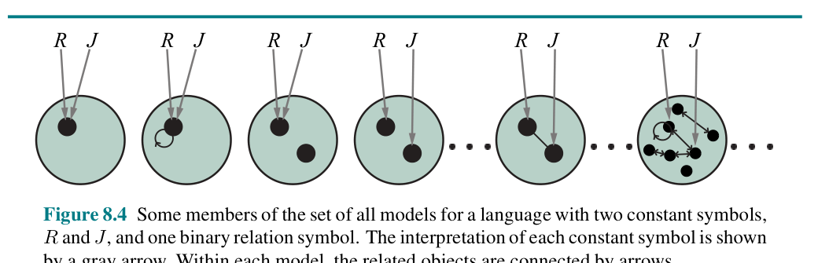
Chapter 8
34
THE UNIVERSE OF ALL FOL MODELS
Models can have different domain sizes
Constants can map to objects in many ways
Relations can include many tuple sets
Entailment cannot enumerate all models
Figure 8.4: many possible models for R, J, and one relation.
Notes:
The universe of all FOL models Use this figure to contrast Chapter 7 truth tables. Propositional model checking enumerates truth assignments. FOL has unbounded domains and interpretations, so brute-force enumeration is not generally available. This is why inference in FOL becomes a deeper topic in Chapter 9. Teaching gotcha: Students often memorize symbols but miss the modeling choice. Keep asking: what exists in our world, what names do we give it, and what can the KB prove?

Slide 35
COMP 469
8.2.8 Database Semantics
A different interpretation style
35
Notes:
8.2.8 Database Semantics The uploaded chapter places database semantics after the summary text, but conceptually it belongs in the syntax/semantics section. Present it here because it directly follows standard FOL semantics and equality. Teaching gotcha: Students often memorize symbols but miss the modeling choice. Keep asking: what exists in our world, what names do we give it, and what can the KB prove?

Slide 36
Chapter 8
36
STANDARD FOL VS. DATABASE THINKING
Standard FOL is open-world
Different names may refer to same object
Unknown facts are not automatically false
Databases often assume more certainty
Analogy
A detective board stays open to unknown suspects; a completed attendance sheet assumes only listed students are present.
Class check
In standard FOL, can Richard have another brother not named in the KB?
Notes:
Standard FOL vs. database thinking Answer: yes, unless the KB rules it out. This is the open-world assumption. Students who use SQL may expect database behavior by default; clarify that logic systems can choose semantics. Teaching gotcha: Students often memorize symbols but miss the modeling choice. Keep asking: what exists in our world, what names do we give it, and what can the KB prove?

Slide 37
Chapter 8
37
DATABASE SEMANTICS ASSUMPTIONS
Unique names: different constants are different objects
Closed world: unknown atomic facts are false
Domain closure: no unnamed domain objects
Useful when data is complete
Analogy
A restaurant reservation list: if your name is not on the list, the host treats that as “not reserved.”
not in table ⇒ false
Class check
When would this be dangerous?
Notes:
Database semantics assumptions Database semantics is convenient but risky when the world is incomplete. For AI agents in messy environments, absence of evidence is not always evidence of absence. Teaching gotcha: Students often memorize symbols but miss the modeling choice. Keep asking: what exists in our world, what names do we give it, and what can the KB prove?

Slide 38
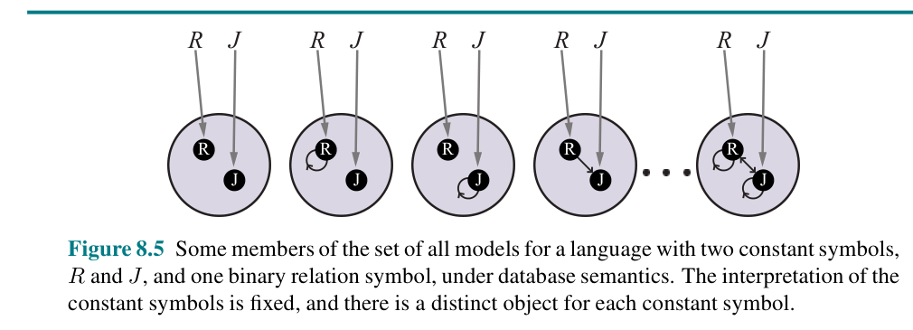
Chapter 8
38
DATABASE SEMANTICS MODELS
Constants have fixed distinct objects
Only named objects exist
Relation tuples vary over fixed objects
Much fewer models than standard FOL
Figure 8.5: models under database semantics.
Notes:
Database semantics models Connect the figure to the assumptions. In Figure 8.5, R and J are fixed and distinct. The relation can vary over the four possible ordered pairs. With two objects and one binary relation, there are 2^4 = 16 possible relation extensions. Teaching gotcha: Students often memorize symbols but miss the modeling choice. Keep asking: what exists in our world, what names do we give it, and what can the KB prove?

Slide 39
Chapter 8
39
NO ONE CORRECT SEMANTICS
Semantics are modeling choices
Standard FOL works well with incomplete knowledge
Database semantics works well with complete records
Choose based on the task
Analogy
A weather forecast app should not assume “not reported” means “not raining”; a gradebook may safely treat missing assignment as zero by policy.
Class check
Ask students to classify: medical diagnosis KB or course enrollment database?
Notes:
No one correct semantics This slide reinforces the practical skill. Logic is not only symbol manipulation; it is choosing assumptions that fit the environment and the data. Teaching gotcha: Students often memorize symbols but miss the modeling choice. Keep asking: what exists in our world, what names do we give it, and what can the KB prove?

Slide 40
COMP 469
8.3 Using First-Order Logic
Writing useful knowledge, not just legal formulas
40
Notes:
8.3 Using First-Order Logic Although the uploaded chapter excerpt emphasizes Wumpus World, family/king examples, and circuits, the core skill is translation: choose vocabulary, write axioms, ask queries. Teaching gotcha: Students often memorize symbols but miss the modeling choice. Keep asking: what exists in our world, what names do we give it, and what can the KB prove?

Slide 41
Chapter 8
41
TRANSLATION WORKFLOW
Identify objects in the domain
Choose predicates for properties/relations
Choose functions for unique mappings
Write rules with quantifiers
Analogy
Translation is like designing a database schema before entering data.
English → vocabulary → FOL sentence
Class check
Do not translate word-by-word; translate meaning.
Notes:
Translation workflow Students often translate too literally. Show that “has a crown” can become ∃x Crown(x) ∧ OnHead(x,John), not a predicate HasACrown(John) unless that predicate is useful. Teaching gotcha: Students often memorize symbols but miss the modeling choice. Keep asking: what exists in our world, what names do we give it, and what can the KB prove?

Slide 42
Chapter 8
42
RULE COMPRESSION IN WUMPUS WORLD
Propositional logic repeats rules by square
FOL introduces square variables
Adjacency becomes a reusable relation
One schema covers the grid
Analogy
Instead of writing separate safety instructions for every room, write one rule about rooms adjacent to hazards.
∀s Breezy(s) ⇔ ∃p(Pit(p) ∧ Adjacent(p,s))
Class check
Where is the domain knowledge hidden in this sentence?
Notes:
Rule compression in Wumpus World Answer: in the definitions of Breezy, Pit, and Adjacent. The sentence is compact, but the predicates must still be chosen and defined carefully. Teaching gotcha: Students often memorize symbols but miss the modeling choice. Keep asking: what exists in our world, what names do we give it, and what can the KB prove?

Slide 43
Chapter 8
43
WUMPUS SMELL RULE
The same pattern handles Wumpus location
Smelly squares are adjacent to the Wumpus
Biconditional supports positive and negative inference
A one-way rule may be too weak
Analogy
A smoke detector rule: smoke near fire and fire near smoke are not the same unless both directions are specified.
∀s Smelly(s) ⇔ ∃w(Wumpus(w) ∧ Adjacent(w,s))
Class check
Why might ⇒ be insufficient if the agent needs to prove safety?
Notes:
Wumpus smell rule This connects directly to the knowledge-engineering debug example: if the KB only says Smelly(s) ⇒ Adjacent(Home(Wumpus),s), it may fail to prove absence of Wumpus. Biconditionals matter when reasoning in both directions. Teaching gotcha: Students often memorize symbols but miss the modeling choice. Keep asking: what exists in our world, what names do we give it, and what can the KB prove?

Slide 44
Chapter 8
44
ASKVARS-STYLE QUESTIONS
Queries can ask for objects, not just true/false
Variables in queries become answer slots
Answers are substitutions
Useful for planning and diagnosis
Analogy
Instead of asking “is there a safe square?”, ask “which squares are safe?”
ASKVARS x: Safe(x)
Class check
What should the answer format look like?
Notes:
ASKVARS-style questions Chapter 8 uses ASKVARS in the circuit example. The idea is that a query with variables returns bindings that make the query entailed. This is a precursor to logic programming and database queries. Teaching gotcha: Students often memorize symbols but miss the modeling choice. Keep asking: what exists in our world, what names do we give it, and what can the KB prove?

Slide 45
Chapter 8
45
OBJECTS OR PREDICATES?
Pit as object: Pit₁ located at S₂₂
Pit as predicate: Pit(S₂₂)
Both can be legal
Good ontology depends on questions
Analogy
Modeling is like choosing classes in software design: more than one design works, but some make later questions easier.
Class check
Would you represent Course as an object or Enrolled as a relation?
Notes:
Objects or predicates? This is a major conceptual skill. FOL does not force a single ontology. The “right” choice is often the one that supports the intended inferences naturally. Teaching gotcha: Students often memorize symbols but miss the modeling choice. Keep asking: what exists in our world, what names do we give it, and what can the KB prove?

Slide 46
COMP 469
8.4 Knowledge Engineering in FOL
From formulas to a working knowledge base
46
Notes:
8.4 Knowledge Engineering in FOL This final section is the engineering side: how to build and debug a KB. Position this as the practical takeaway: good AI reasoning depends on good modeling. Teaching gotcha: Students often memorize symbols but miss the modeling choice. Keep asking: what exists in our world, what names do we give it, and what can the KB prove?

Slide 47
Chapter 8
47
KNOWLEDGE ENGINEERING: THE BIG PICTURE
Investigate the domain
Choose an ontology
Encode general axioms
Add problem facts and ask queries
Debug against expected answers
Analogy
Building a KB is like designing a lab experiment: define what you measure, control variables, then test whether results make sense.
Class check
Why is “debugging the KB” different from debugging Python code?
Notes:
Knowledge engineering: the big picture The answers are usually correct relative to the KB as written. If they are surprising, the issue may be missing knowledge, wrong ontology, or weak axioms. This distinction is important for students. Teaching gotcha: Students often memorize symbols but miss the modeling choice. Keep asking: what exists in our world, what names do we give it, and what can the KB prove?

Slide 48
Chapter 8
48
STEP 1: IDENTIFY THE QUESTIONS
What must the KB answer?
What facts will be given?
What level of detail is needed?
The task determines the vocabulary
Analogy
Before building a GPS app, decide whether it needs routes, traffic, gas stations, or scenic stops.
Class check
Circuit example: functionality? connectivity? timing? power?
Notes:
Step 1: identify the questions This echoes PEAS from Chapter 2. If the questions are about gate-level functionality, we do not need wire color or physical cost. If questions change, the ontology may need to change. Teaching gotcha: Students often memorize symbols but miss the modeling choice. Keep asking: what exists in our world, what names do we give it, and what can the KB prove?

Slide 49
Chapter 8
49
STEP 2: ASSEMBLE RELEVANT KNOWLEDGE
Talk to experts or inspect the domain
Separate relevant from irrelevant facts
Know the domain before formalizing it
Artificial domains are easier than real ones
Analogy
Packing for a trip: bring what supports the goal, not everything in the closet.
Class check
For circuits, do we need wire length? It depends on whether timing matters.
Notes:
Step 2: assemble relevant knowledge Students may try to include everything. Explain that knowledge engineering is also abstraction. The right abstraction is task-specific. Teaching gotcha: Students often memorize symbols but miss the modeling choice. Keep asking: what exists in our world, what names do we give it, and what can the KB prove?

Slide 50
Chapter 8
50
STEP 3: CHOOSE VOCABULARY / ONTOLOGY
Constants name specific objects
Predicates classify and relate objects
Functions capture unique mappings
Ontology determines what kinds of things exist
Analogy
An ontology is like the noun-and-verb list for a domain-specific language.
Gate(X₁), Type(X₁)=XOR, In(1,C₁)
Class check
What vocabulary would you choose for course enrollment?
Notes:
Step 3: choose vocabulary / ontology This is a good place to connect to software design: class names, methods, and relationships. FOL is not object-oriented programming, but the modeling instincts overlap. Teaching gotcha: Students often memorize symbols but miss the modeling choice. Keep asking: what exists in our world, what names do we give it, and what can the KB prove?

Slide 51
Chapter 8
51
STEP 4: ENCODE GENERAL KNOWLEDGE
Write axioms for vocabulary terms
Prefer clear general rules
Use biconditionals when both directions matter
Check for missing assumptions
Analogy
Axioms are the operating manual for the world the KB understands.
Connected(t₁,t₂) ⇒ Signal(t₁)=Signal(t₂)
Class check
What does this axiom assume about wires?
Notes:
Step 4: encode general knowledge The circuit domain ignores wire faults and delays. The axiom is reasonable for a simplified functional model but not for diagnosing electrical faults. This is a great abstraction discussion. Teaching gotcha: Students often memorize symbols but miss the modeling choice. Keep asking: what exists in our world, what names do we give it, and what can the KB prove?

Slide 52
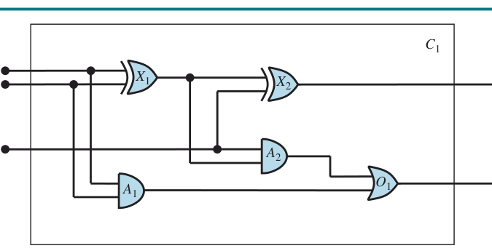
Chapter 8
52
ELECTRONIC CIRCUIT DOMAIN
The circuit is a one-bit full adder
Inputs: two bits plus carry-in
Outputs: sum and carry-out
Gates: XOR, AND, OR
Figure 8.6: circuit C₁ with X₁, X₂, A₁, A₂, O₁.
Notes:
Electronic circuit domain Use the figure to show why FOL is natural: circuits contain parts and connections. The KB can ask questions about function and structure. Students do not need electrical engineering background; it is a clean relational domain. Teaching gotcha: Students often memorize symbols but miss the modeling choice. Keep asking: what exists in our world, what names do we give it, and what can the KB prove?

Slide 53
Chapter 8
53
CIRCUIT ONTOLOGY
Circuit(c), Gate(g), Terminal(t)
Type(g) = AND/OR/XOR/NOT
In(n,c), Out(n,c)
Connected(t₁,t₂), Signal(t)
Analogy
The ontology is a parts list plus a wiring diagram plus signal values.
Class check
Which are predicates and which are functions?
Notes:
Circuit ontology Have students classify each term. Circuit(c), Gate(g), Terminal(t), Connected are predicates. Type, In, Out, Signal are functions. This exercise reinforces syntax. Teaching gotcha: Students often memorize symbols but miss the modeling choice. Keep asking: what exists in our world, what names do we give it, and what can the KB prove?

Slide 54
Chapter 8
54
GATE BEHAVIOR AXIOMS
AND output is 0 if any input is 0
OR output is 1 if any input is 1
XOR output is 1 if inputs differ
NOT output differs from input
Analogy
A gate axiom is like a truth table compressed into a reusable rule.
Type(g)=XOR ⇒ Signal(Out(1,g))=1 ⇔ Signal(In(1,g))≠Signal(In(2,g))
Class check
Why is XOR harder to express than AND/OR?
Notes:
Gate behavior axioms Students may be more familiar with truth tables. Explain that FOL can encode truth table behavior generically for every gate of a type, not just for a specific gate. Teaching gotcha: Students often memorize symbols but miss the modeling choice. Keep asking: what exists in our world, what names do we give it, and what can the KB prove?

Slide 55
Chapter 8
55
STEP 5: ENCODE THE PROBLEM INSTANCE
Assert C₁ is a circuit with arity 3,2
Declare X₁, X₂, A₁, A₂, O₁ as gates
Assign each gate type
Assert all terminal connections
Analogy
The ontology is the template; the problem instance is today’s actual circuit on the bench.
Gate(X₁) ∧ Type(X₁)=XOR
Class check
Why do we separate general rules from instance facts?
Notes:
Step 5: encode the problem instance General rules are reusable across circuits. Instance facts describe this particular circuit. This separation is the main benefit of a declarative KB. Teaching gotcha: Students often memorize symbols but miss the modeling choice. Keep asking: what exists in our world, what names do we give it, and what can the KB prove?

Slide 56
Chapter 8
56
STEP 6: POSE QUERIES
Ask for input combinations
Ask for output values
Ask for connected components
Answers are entailed substitutions
Analogy
Like SQL SELECT, a FOL query can return variable bindings that satisfy conditions.
∃i₁,i₂,i₃: outputs are sum=0, carry=1
Class check
Predict the three inputs that produce carry=1 and sum=0.
Notes:
Step 6: pose queries The answer is 110, 101, 011. Connect this to full-adder behavior: exactly two input bits are 1. The KB can prove this from the structure and gate axioms. Teaching gotcha: Students often memorize symbols but miss the modeling choice. Keep asking: what exists in our world, what names do we give it, and what can the KB prove?

Slide 57
8.4 Circuit verification
57
FULL-ADDER TRUTH TABLE CHECK
A B Cin | Sum Carry
0 0 0 | 0 0
0 0 1 | 1 0
0 1 0 | 1 0
0 1 1 | 0 1
1 0 0 | 1 0
1 0 1 | 0 1
1 1 0 | 0 1
1 1 1 | 1 1
Analogy
Verification is like checking every row of a recipe conversion chart: the KB must match expected behavior for all cases.
ASKVARS → substitutions that satisfy the query
Class check
Which rows have Sum=0 and Carry=1?
Notes:
Full-adder truth table check This slide gives students a concrete target for circuit verification. The KB is not doing arithmetic by magic; it derives signal relationships from the gate structure. Rows with Sum=0 and Carry=1 correspond to exactly two input bits being high: 011, 101, and 110. Teaching gotcha: Students often memorize symbols but miss the modeling choice. Keep asking: what exists in our world, what names do we give it, and what can the KB prove?

Slide 58
Chapter 8
58
STEP 7: DEBUG AND EVALUATE
Unexpected answers reveal modeling problems
Missing axioms stop reasoning chains
Weak axioms fail to prove negative facts
Use test queries, not intuition alone
Analogy
Debugging a KB is like debugging a legal contract: the text may be internally valid but not say what you intended.
Missing: 1 ≠ 0
Class check
What breaks if the KB does not know 1 and 0 are different?
Notes:
Step 7: debug and evaluate Use the chapter’s XOR example: if the system cannot infer 1 ≠ 0, it cannot prove XOR outputs for cases where inputs differ. This is a concrete example of a missing axiom. Teaching gotcha: Students often memorize symbols but miss the modeling choice. Keep asking: what exists in our world, what names do we give it, and what can the KB prove?

Slide 59
Chapter 8
59
DEBUGGING WEAK BICONDITIONALS
One-way rules may not support absence proofs
Biconditionals are stronger but must be true
Too strong axioms create false entailments
Test both positive and negative queries
Analogy
A sign “fire causes smoke” does not prove that no smoke means no fire unless the rule is biconditional and complete.
Smelly(s) ⇔ Adjacent(Home(Wumpus),s)
Class check
Why can a one-way smell rule fail a safe-square query?
Notes:
Debugging weak biconditionals This is a critical practical gotcha. Students may write only one direction of rules because it is easier. But if the agent needs to prove absence, it may need the reverse direction too. Teaching gotcha: Students often memorize symbols but miss the modeling choice. Keep asking: what exists in our world, what names do we give it, and what can the KB prove?

Slide 60
Chapter 8
60
EVALUATE WITH A TEST SUITE
Define expected answers before grading the KB
Include edge cases and negative cases
Measure correctness objectively
Revise ontology or axioms when needed
Analogy
A KB test suite is like unit tests for a Python project, but tests the model of the world.
Class check
Have students design three tests for the circuit KB.
Notes:
Evaluate with a test suite Good tests include: all-zero input returns zero outputs; XOR output is 1 for 10 and 01; carry is 1 when at least two inputs are high. Tests reveal missing equality, incorrect gate types, or missing connections. Teaching gotcha: Students often memorize symbols but miss the modeling choice. Keep asking: what exists in our world, what names do we give it, and what can the KB prove?

Slide 61
COMP 469
Limits and Next Steps
Why Chapter 8 leads to Chapter 9 and beyond
61
Notes:
Limits and Next Steps Close the chapter by showing why FOL is powerful but not the whole story. FOL improves representation but makes inference more complex. Chapter 9 focuses on inference procedures. Teaching gotcha: Students often memorize symbols but miss the modeling choice. Keep asking: what exists in our world, what names do we give it, and what can the KB prove?

Slide 62
Chapter 8
62
LIMITS OF FOL
More expressive languages can be harder to reason with
Vague predicates are difficult: Tall(x), Tasty(x)
Uncertainty needs probability, not just true/false/unknown
Large KBs require careful engineering
Analogy
A recipe can state “add enough salt,” but formal logic struggles with “enough” unless we define it precisely.
Class check
Ask: Is GoodRestaurant(x) a clean logical predicate?
Notes:
Limits of FOL The chapter summary notes that propositional and first-order logic both struggle with vague propositions. This prepares students for probability and uncertainty later in the course. Teaching gotcha: Students often memorize symbols but miss the modeling choice. Keep asking: what exists in our world, what names do we give it, and what can the KB prove?

Slide 63
Chapter 8
63
WHY THIS MATTERS FOR AI AGENTS
Agents need knowledge, not just search
FOL lets agents generalize rules
Inference derives new facts from old facts
Knowledge engineering connects AI to domains
Analogy
A delivery robot needs more than a map: it needs to know doors, people, rooms, permissions, and relationships.
representation → inference → action
Class check
Which parts of a campus robot’s world require objects and relations?
Notes:
Why this matters for AI agents Tie back to the course. Search answers “how do I get there?” Logic answers “what is there, what follows, and what can I safely assume?” AI systems often need both. Teaching gotcha: Students often memorize symbols but miss the modeling choice. Keep asking: what exists in our world, what names do we give it, and what can the KB prove?

Slide 64
Review
64
CHAPTER 8 SUMMARY / REVIEW
FOL represents objects, relations, functions, and quantified rules
A model gives meaning through a domain and interpretation
Quantifier order and connective choice change meaning
Database semantics adds unique-name, closed-world, and domain-closure assumptions
Knowledge engineering turns domain expertise into a queryable KB
Big analogy
FOL is a blueprint language for knowledge: it names the parts, draws the relationships, and lets inference inspect the structure.
Notes:
Summary / review Use this as the recap before moving to exercises. Ask students to explain the difference between a term and a sentence, then the difference between ∀x∃y and ∃y∀x. If they can do those two things, they have the foundation for Chapter 9 inference. Teaching gotcha: Students often memorize symbols but miss the modeling choice. Keep asking: what exists in our world, what names do we give it, and what can the KB prove?

Slide 65
Practice
65
EXIT TICKET: 5-MINUTE CHECK
Translate: “Every course has an instructor.”
Translate: “Some student is enrolled in COMP 469.”
Explain why ∀x∃y Advisor(x,y) differs from ∃y∀x Advisor(x,y).
Name one database-semantics assumption.
Write one test query for the circuit KB.
Instructor use
This is a diagnostic, not a trick. The goal is to catch symbol misunderstandings before Chapter 9.
Notes:
Exit ticket Suggested answers: ∀c Course(c) ⇒ ∃i Instructor(i,c) if Instructor is a relation; ∃s Student(s) ∧ Enrolled(s, COMP469); the first allows different advisors for different students while the second says one advisor for everyone; database assumptions include unique names, closed world, and domain closure. Teaching gotcha: Students often memorize symbols but miss the modeling choice. Keep asking: what exists in our world, what names do we give it, and what can the KB prove?

Slide 66
References
66
REFERENCES AND TEACHING RESOURCES
Russell & Norvig, Artificial Intelligence: A Modern Approach, 4th ed., Chapter 8
AIMA official site: https://aima.cs.berkeley.edu/
AIMA Python logic code: https://github.com/aimacode/aima-python/blob/master/aima/logic.py
Berkeley CS188 logic notes: https://inst.eecs.berkeley.edu/~cs188/
AIMA FOL exercises: https://aimacode.github.io/aima-exercises/fol-exercises/
Notes:
References These references can be shown at the end or posted in Canvas. Emphasize that AIMA Python is useful for code examples, while CS188 notes are often helpful as alternate explanations. Students should not use them as a substitute for understanding the semantics of models and quantifiers. Teaching gotcha: Students often memorize symbols but miss the modeling choice. Keep asking: what exists in our world, what names do we give it, and what can the KB prove?

